Slide 1
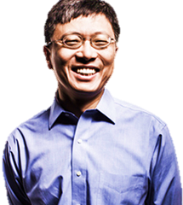




To change flags:
Go to Wikipedia and search for desired country’s flag
Right-click and “save as” to pictures folder
Go to PowerPoint and single-left-click the grouped flag pictures/shapes above. Single-left-click again on the foreign flag.
Now single-right-click the foreign flag and select “change picture” from the menu.
Choose the picture file you saved.
You may wish to single-left-click the grouped flag pictures/shapes and single-left-click the new foreign flag again to adjust its size--especially important if the flag is not the same aspect ratio as the US flag (e.g. Nepal, Phillipines)
Select the grouped flag pictures/shapes—copy it. Next, in a blank area, right-click and click the down arrow on the paste button from the Home ribbon menu above. Choose the paste icon with a mountain picture on it (“paste as picture”)—then re-size this image as necessary to place it on the poster.
Diverse
To change picture:
Save the picture of the person you wish to use.
Right-click the picture on the poster and select “Change Picture” from the menu.
Choose the picture file you saved.
Heung-Yeung
“Harry” Shum
Chinese American
They
You
Executive Vice President of artificial intelligence and research at Microsoft
Leading and motivating your fellow airmen
Can
Can
Fellow—Institute of Electrical & Electronics Engineers
Fellow—Association for Computing Machinery
Security+ Certificate
Cyber Role Models
Do
Do
Published over 200 papers focusing on computer graphics and computer vision
How will you share what you have learned with your fellow airmen?
It
It
Elected to the National Academy of Engineering of the United States
How will you give back after being recognized for your accomplishments?
What traits of this role model can you embody to become a leader?

